Slide 1
General Chemistry
2018 Spring Semester
Jim Jr-Min Lin
林志民 博士
中央研究院原子與分子科學研究所研究員
台灣大學化學系合聘教授

Slide 2
左承叡 成凱翔 李鈺琳 林妍秀
TA hour : 一89 四567
TAs:
如何提問
一律用A5紙(半張A4)，以便整理
寫明系級、學號、姓名(會加分)
寫下問題、交給TA、並確定TA明白你的問題
TA幫你發問(具名或匿名)

Slide 3
Teaching Goal
Help a student learn to solve (answer) practical (realistic) questions/problems. 教入世的學問
Strategy
逐漸拆去溫室的隔牆，呈現真實的世界，including using practical numbers and units.
Target
Knowledge is useful in real life.

Slide 4
Photochemistry
1. Estimate the protection of the stratospheric ozone layer. Estimate the UV spectrum of sunlight at earth’s surface. [3/12交]
Chemical Reaction Kinetics
2. Estimate the global production rate of CH₄.
Thermal Dynamics
3. Estimate the thermal-dynamics-limit efficiencies of an air conditioner and a heat pump.
Quantum Mechanics
4. Estimate the tunneling current(? probability) of a scanning tunneling microscope.

Slide 5
Quantum Mechanics + Molecular Spectroscopy
5. Analyze the infrared spectrum of HCl.
Quantum Mechanics + Reaction Dynamics
6. Greenhouse gas: how it works
Electrochemistry
7. Zinc plated steel versus copper contacted aluminum
Wave-particle Duality
8. Under what conditions, you have to use quantum mechanics?
Under what conditions, classical mechanics is also fine?

Slide 6
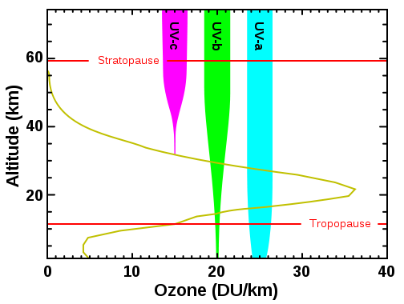
The ozone layer in the stratosphere blocks harmful high energy UV photons from the sun. This protection is due to two factors: large absorption cross section and high concentration of ozone.
Ref: Wiki: Ozone in Earth's atmosphere
Wiki

Slide 7
Beer-Lambert Law for light absorption
Note: There are two definitions for Absorbance A (base e Vs. base 10)

Slide 8
Cross Section
For a large object like a pen, its cross section depends on the angle of view.
For a molecule, the absorption cross section depends on the interaction between the molecule and light.

Slide 9
HW:
For ozone absorption in the solution, estimate the light transmission at 250, 300, 320 nm. [O₃] =1 mM; path length = 1 cm. Assume the cross section is the same as in the gas phase. (=> Ans_1o)

Slide 10
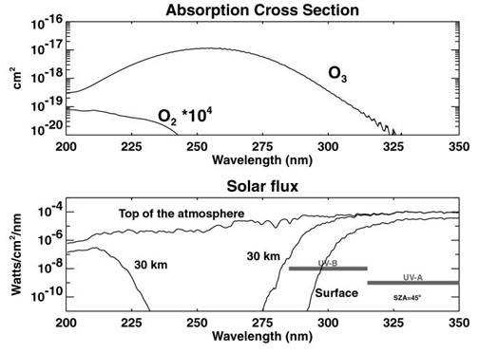
臭氧吸收
陽光強度
UV-B
UV-A

Slide 11
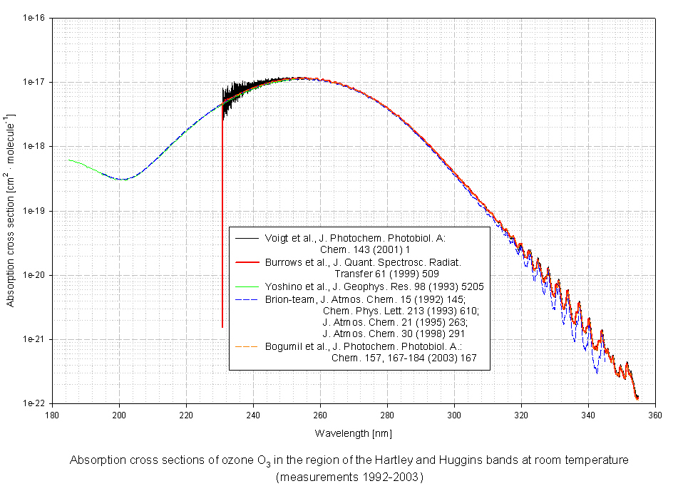
http://satellite.mpic.de/spectral_atlas/cross_sections/Ozone/O3.spc

Slide 12
Wiki: A typical column density of atmospheric ozone is about 300 Dobson Unit (DU). One DU is equivalent to 2.687×10²⁰ molecules per square meter.
Assuming the thickness (range in height) of the ozone layer is about 20 km, estimate the average number density (in molecules per cm³) of the ozone molecules. (=> Ans_1a)
Estimate the transmission of sun light (in %) through the ozone layer at 310 nm and at 300 nm at the noon of the day of summer solstice (夏至) (=> Ans_1b) and winter solstice (冬至) (=> Ans_1c) at Taipei city (緯度：25.0 經度：121.5). This also explains why it is less harmful to do sunbath in the winter or when the sun is low.
How is the ozone hole formed? Describe the chemical processes. Explain why the chemical processes are so efficient such that almost all the ozone molecules in the ozone hole are destroyed? (=> Ans_1d)

Slide 13
f₂(x) = 2^{x} , f₃(x) = 3^{x} , f_{e}(x) = e^{x}
slope at x=0

Slide 14
For light passing through an uniform media, intensity I should has a form of exponential decay.
100%*0.99=99%
99%*0.99=98.01%
98.01%*0.99=97.03%
97.03%*0.99=96.06%
0.99^10=90.4%
0.99^20=81.8%
0.99^40=66.9%
0.99^80=44.8%
0.99^160=20.0%
I₀
I

Slide 15
I₀
I
The decay rate should be proportional to
number density n (in molecule cm⁻³),
path length L (in cm),
and a molecular property σ.
σ n L must be unit less, thus
σ must be in cm² molecule⁻¹. It is in the unit of an area; scientists call it cross section.

Slide 16
Chemical reaction kinetics
reaction = RXN
For a RXN: A + B + … → Products
n+m = order of RXN
rate
rate coefficient
(rate constant)

Slide 17
1st-order RXN:
eg, a spontaneous process, like nuclear decay, fluorescence decay, …
A* → A + hν

Slide 18
2nd-order RXN:
eg, a process requires two molecules
A* + B → A + B
quenching of A* by collision with B
pseudo-1st-order RXN
In the above case, if [A*] << [B], such that
[B](t) = [B]₀ and k[B] does not vary with time.

Slide 19
A more realistic case for a fluorescence molecule A*
A* → A + hν fluorescence, k₁
A* → A (+ heat) non-radiative process, k₂
A* + B → A + B quenching of A* by B, k₃
If [B] >> [A*], such that [B](t) = [B]₀
(pseudo-1st-order)

Slide 20
Even there are three rate coefficients k₁, k₂ and k₃,
the decay of A* only shows single exponential decay.
Experimental observables
Decay rate k’ or lifetime τ =1/k’
Fluorescence quantum yield φ_{FL}

Slide 21
Practice:
If k₁ = 1x10⁶ sec⁻¹
k₂ = 1x10⁶ sec⁻¹
k₃ = 1x10⁻¹⁰ cm³ sec⁻¹
Estimate the fluorescence lifetime and fluorescence quantum yield at [B] = 3x10¹⁶ cm⁻³ and 1x10¹⁹ cm⁻³.
cm³ sec⁻¹ = cm³ molecule⁻¹ sec⁻¹
A* → A + hν fluorescence, k₁
A* → A non-radiative process, k₂
A* + B → A + B quenching of A* by B, k₃

Slide 22
Photochemistry
1. Estimate the protection of the stratospheric ozone layer.
Chemical Reaction Kinetics
2. Estimate the global production rate of CH₄.
Thermal Dynamics
3. Estimate the thermal-dynamics-limit efficiencies of an air conditioner and a heat pump.
Quantum Mechanics
4. Estimate the current of a scanning tunneling microscope.
Quantum Mechanics + Molecular Spectroscopy
5. Analyze the infrared spectrum of HCl.
Quantum Mechanics + Reaction Dynamics
6. Greenhouse gas: how it works

Slide 23
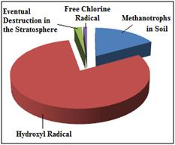
(2) It is known that the majority of atmospheric CH₄ is consumed by its reaction with OH radicals (see below). With http://kinetics.nist.gov, estimate the reaction rate coefficient at 25 degree C and at 0 degree C (=> Ans_2a).
A pie chart demonstrating the relative effects of various sinks of atmospheric methane.
https://en.wikipedia.org/wiki/Atmospheric_methane

Slide 24
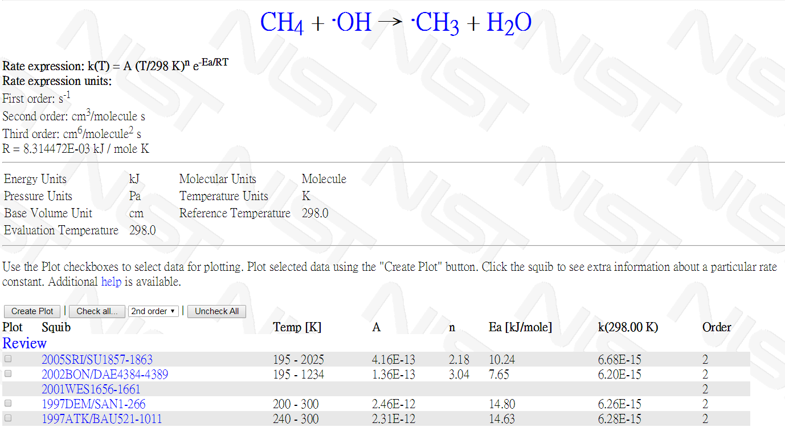
e = exp
6.68x10⁻¹⁵

Slide 25
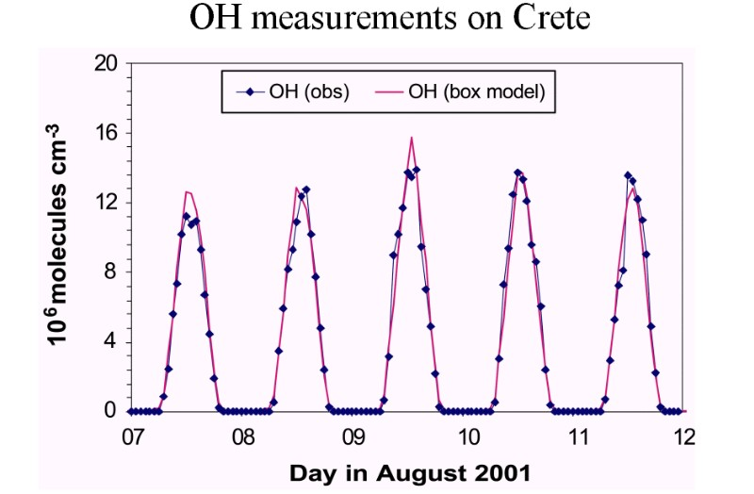
The concentration of atmospheric OH radicals can be measured by utilizing laser-induced fluorescence. For example,
Time profile of OH concentrations over several days.
Source: Presentation J. Lelieveld MPI Mainz 2003

Slide 26
if [CH₄] & k does not vary with time

Slide 27
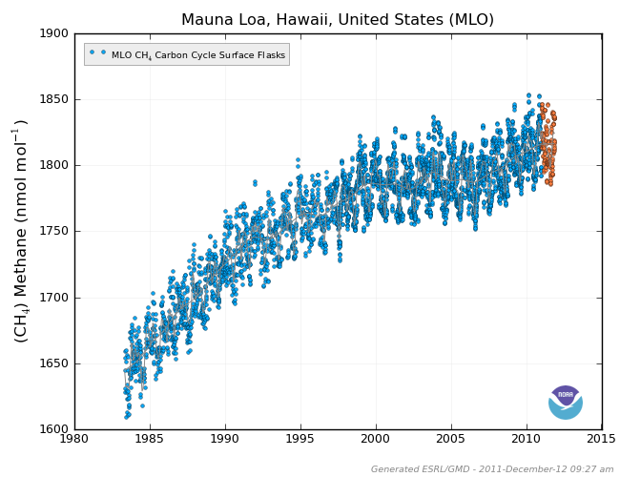
With these data and assuming T = 290 K, estimate the lifetime of atmospheric CH₄ (=> Ans_2b). Note that a lifetime usually means the reciprocal of the averaged first-order decay rate coefficient.
The CH₄ mixing ratio can also be measured. An example is shown in the following figure.

Slide 28
With the above information, we should be able to estimate the global CH₄ emission rate after making some reasonable assumptions (steady-state approximation). Describe your approach and give your answer in molecules/sec and also convert it to Tg/year (=> Ans_2c). Note that the major amount of air is located within 10 km above the sea level (recall the Boltzmann distribution of the air density as a function of height); the surface area of earth is 5.1×10⁸ km².
Considering the consumption rate of CH₄, is it faster in the winter or in the summer? How much faster (roughly)? Give your reasons. (=> Ans_2d)

Slide 29
Get a rough (not-too-bad) answer within a reasonable time.
A rough answer is much better than no answer.
A bad answer may be misleading!

Slide 31
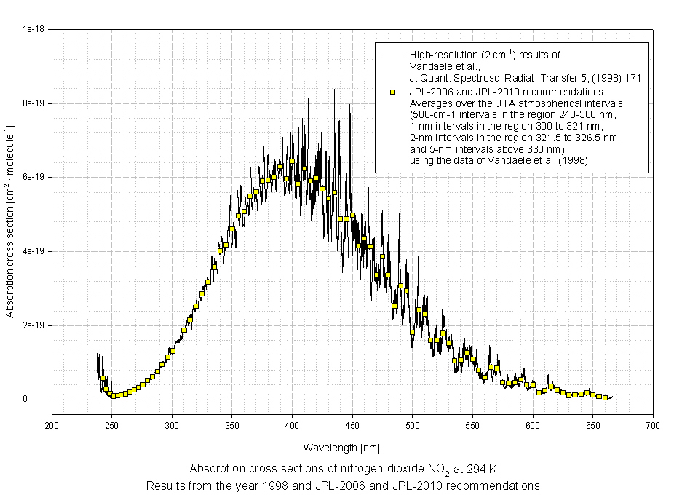
Approx. solar flux
Approx.
cross section

Slide 32
Do better estimation by:
[CH₄] should be good enough.
Use k(T) instead of k(298 K)
Use better <[OH]>. Global Vs. Local
Both [OH] and k(T) depend on altitude.

Slide 33
Wiki: Methane as a greenhouse gas
Methane has a large effect but for a relatively brief period, having an estimated lifetime of 8.9±0.6 years in the atmosphere,[12] whereas carbon dioxide has a small effect for a long period, having an estimated lifetime of over 100 years.

Slide 34
